Slide 1


Slide 2
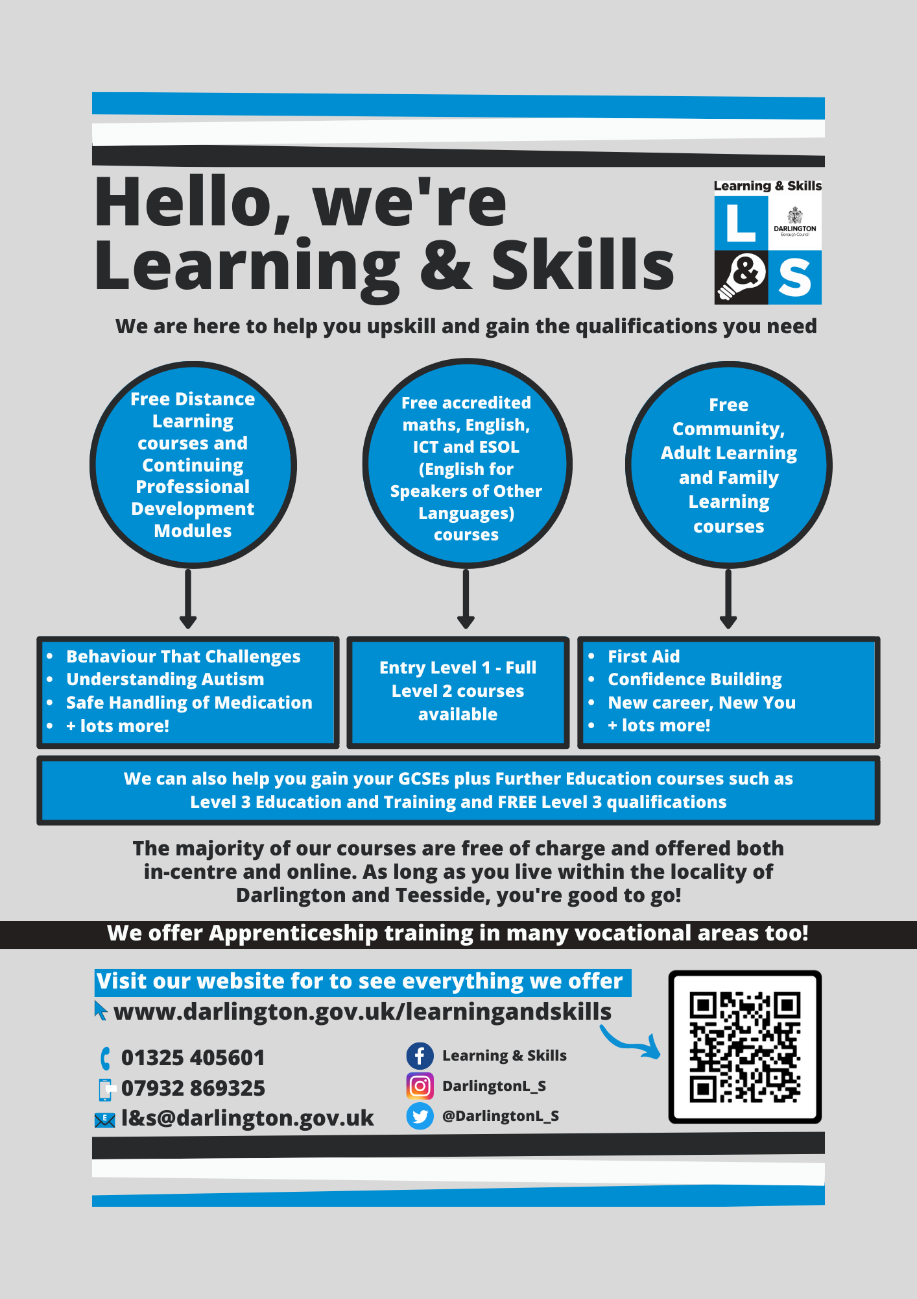

Slide 3
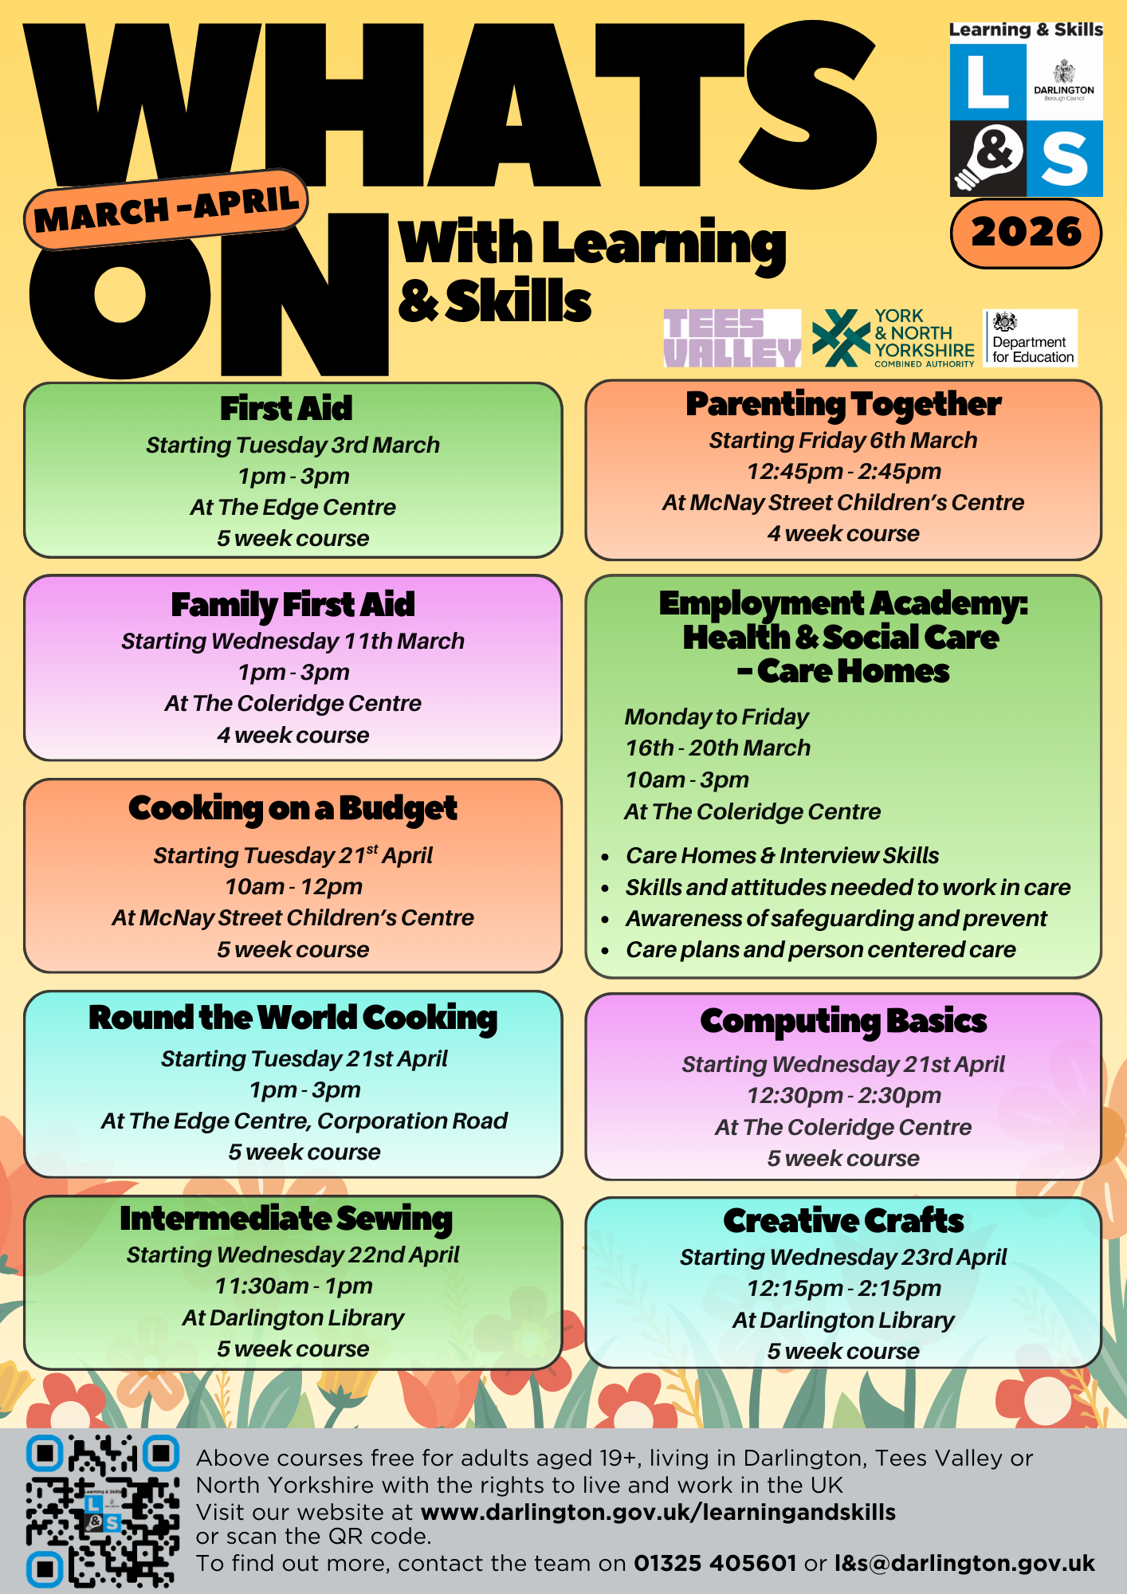
Notes:
Term 2 FL Free Courses.
Parenting-learn how to identify effective parenting strategies, promote self-esteem, use positive communication skills and much more.
Computer skills-learn how to effectively operate a computer/laptop, including safe internet searching, creating documents, adapt settings, using Microsoft Office
Prep work in schools-This course is for people interested in volunteering or working in schools with the opportunity to develop their knowledge on the delivery of the national curriculum, understanding of the school structure, behaviour management
COB- will cover food costing comparisons, supermarket tricks and plenty of recipes, like homemade pizzas, quiche and soup.

Slide 4
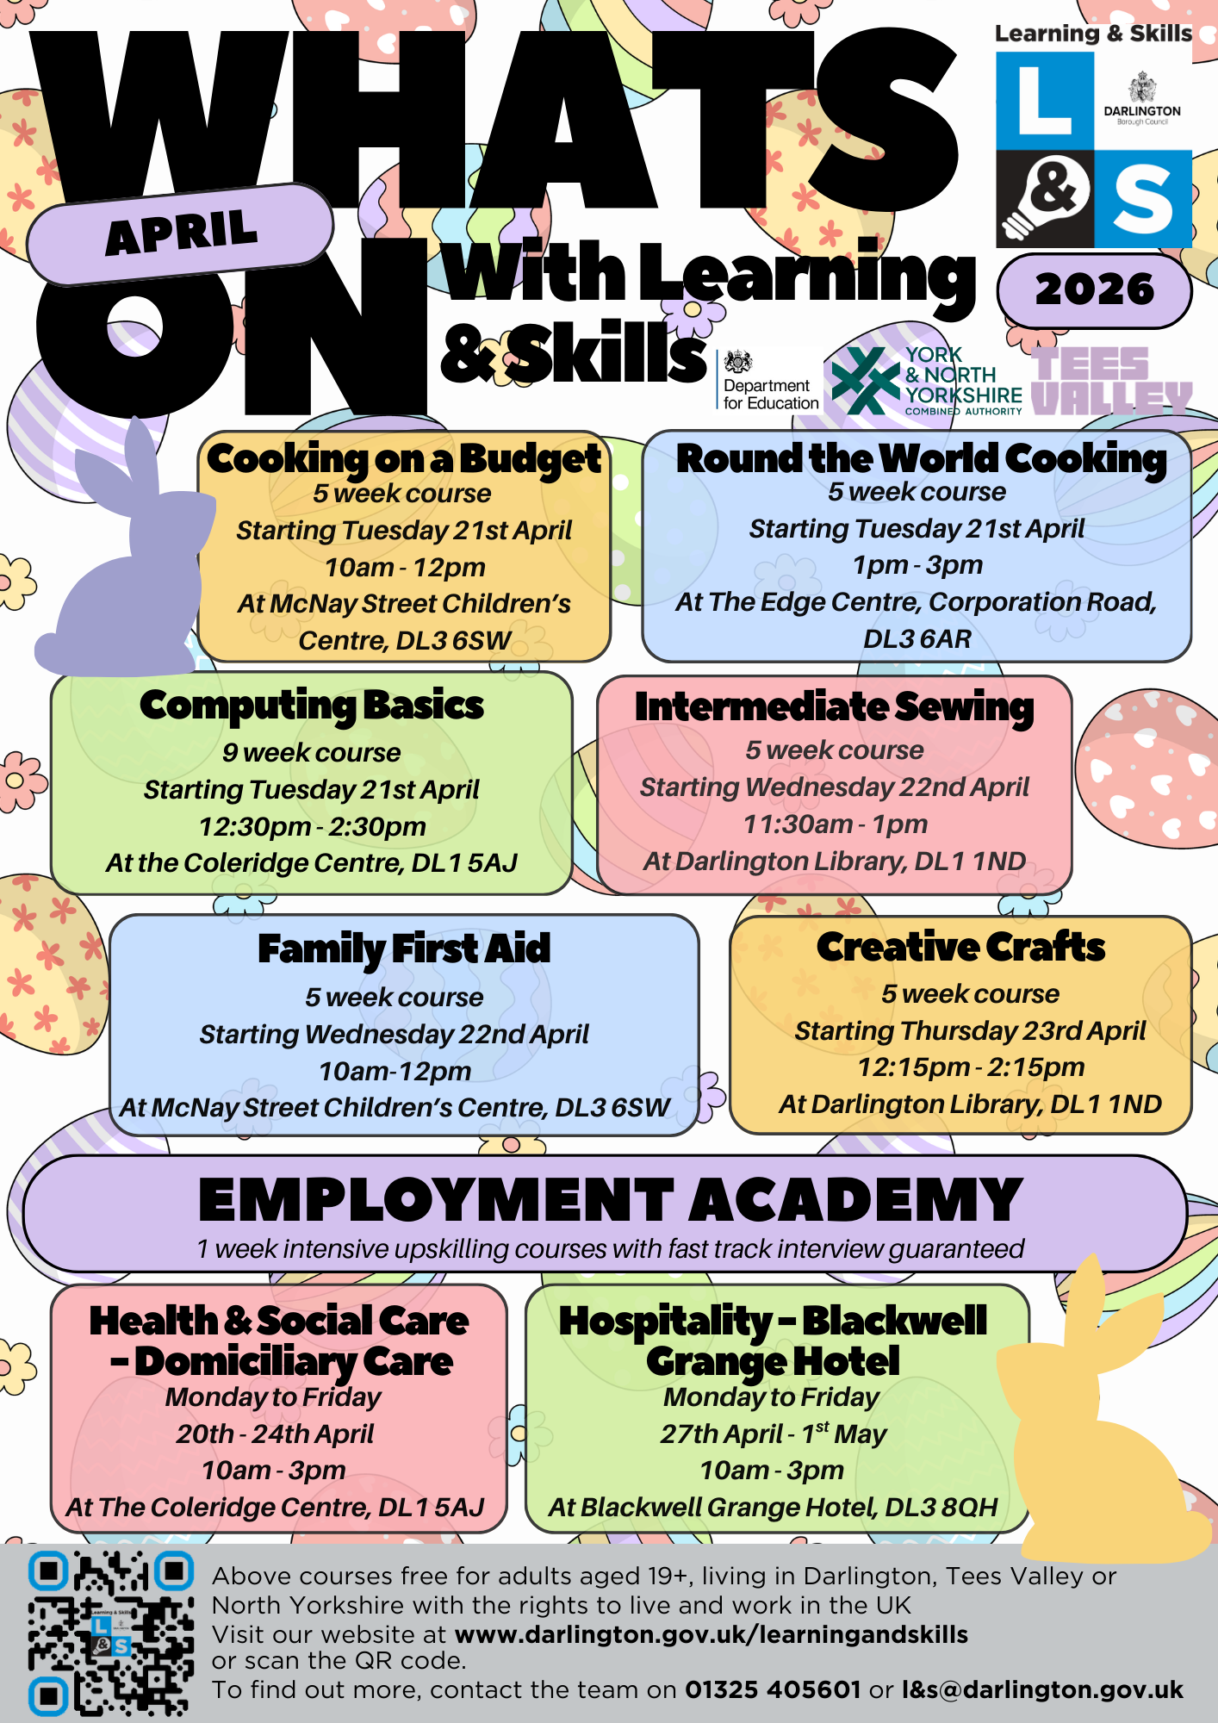
Notes:
Term 2 FL Free Courses.
Parenting-learn how to identify effective parenting strategies, promote self-esteem, use positive communication skills and much more.
Computer skills-learn how to effectively operate a computer/laptop, including safe internet searching, creating documents, adapt settings, using Microsoft Office
Prep work in schools-This course is for people interested in volunteering or working in schools with the opportunity to develop their knowledge on the delivery of the national curriculum, understanding of the school structure, behaviour management
COB- will cover food costing comparisons, supermarket tricks and plenty of recipes, like homemade pizzas, quiche and soup.

Slide 5
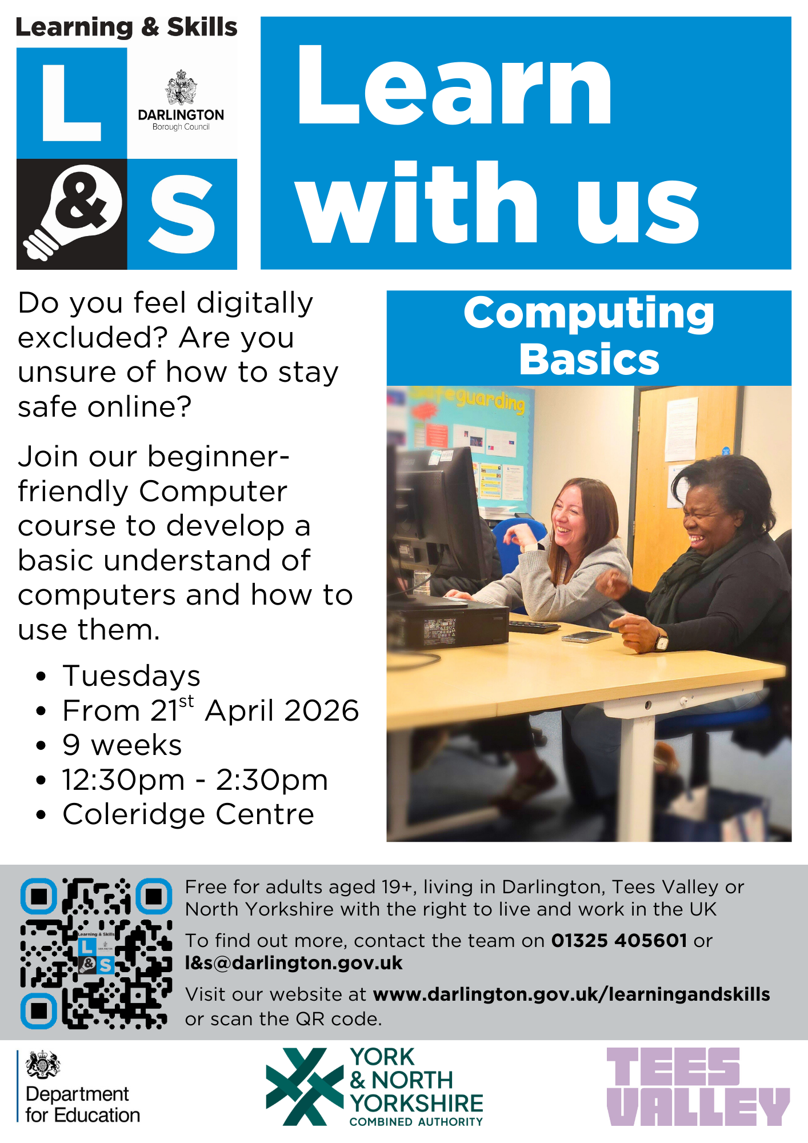
Notes:
This course is for those who does not have an ICT qualification and you would like to build up the basics of ICT and digital skills so that you can carry out the basic operations on a computer/laptop.
Need to complete I/A

Slide 6
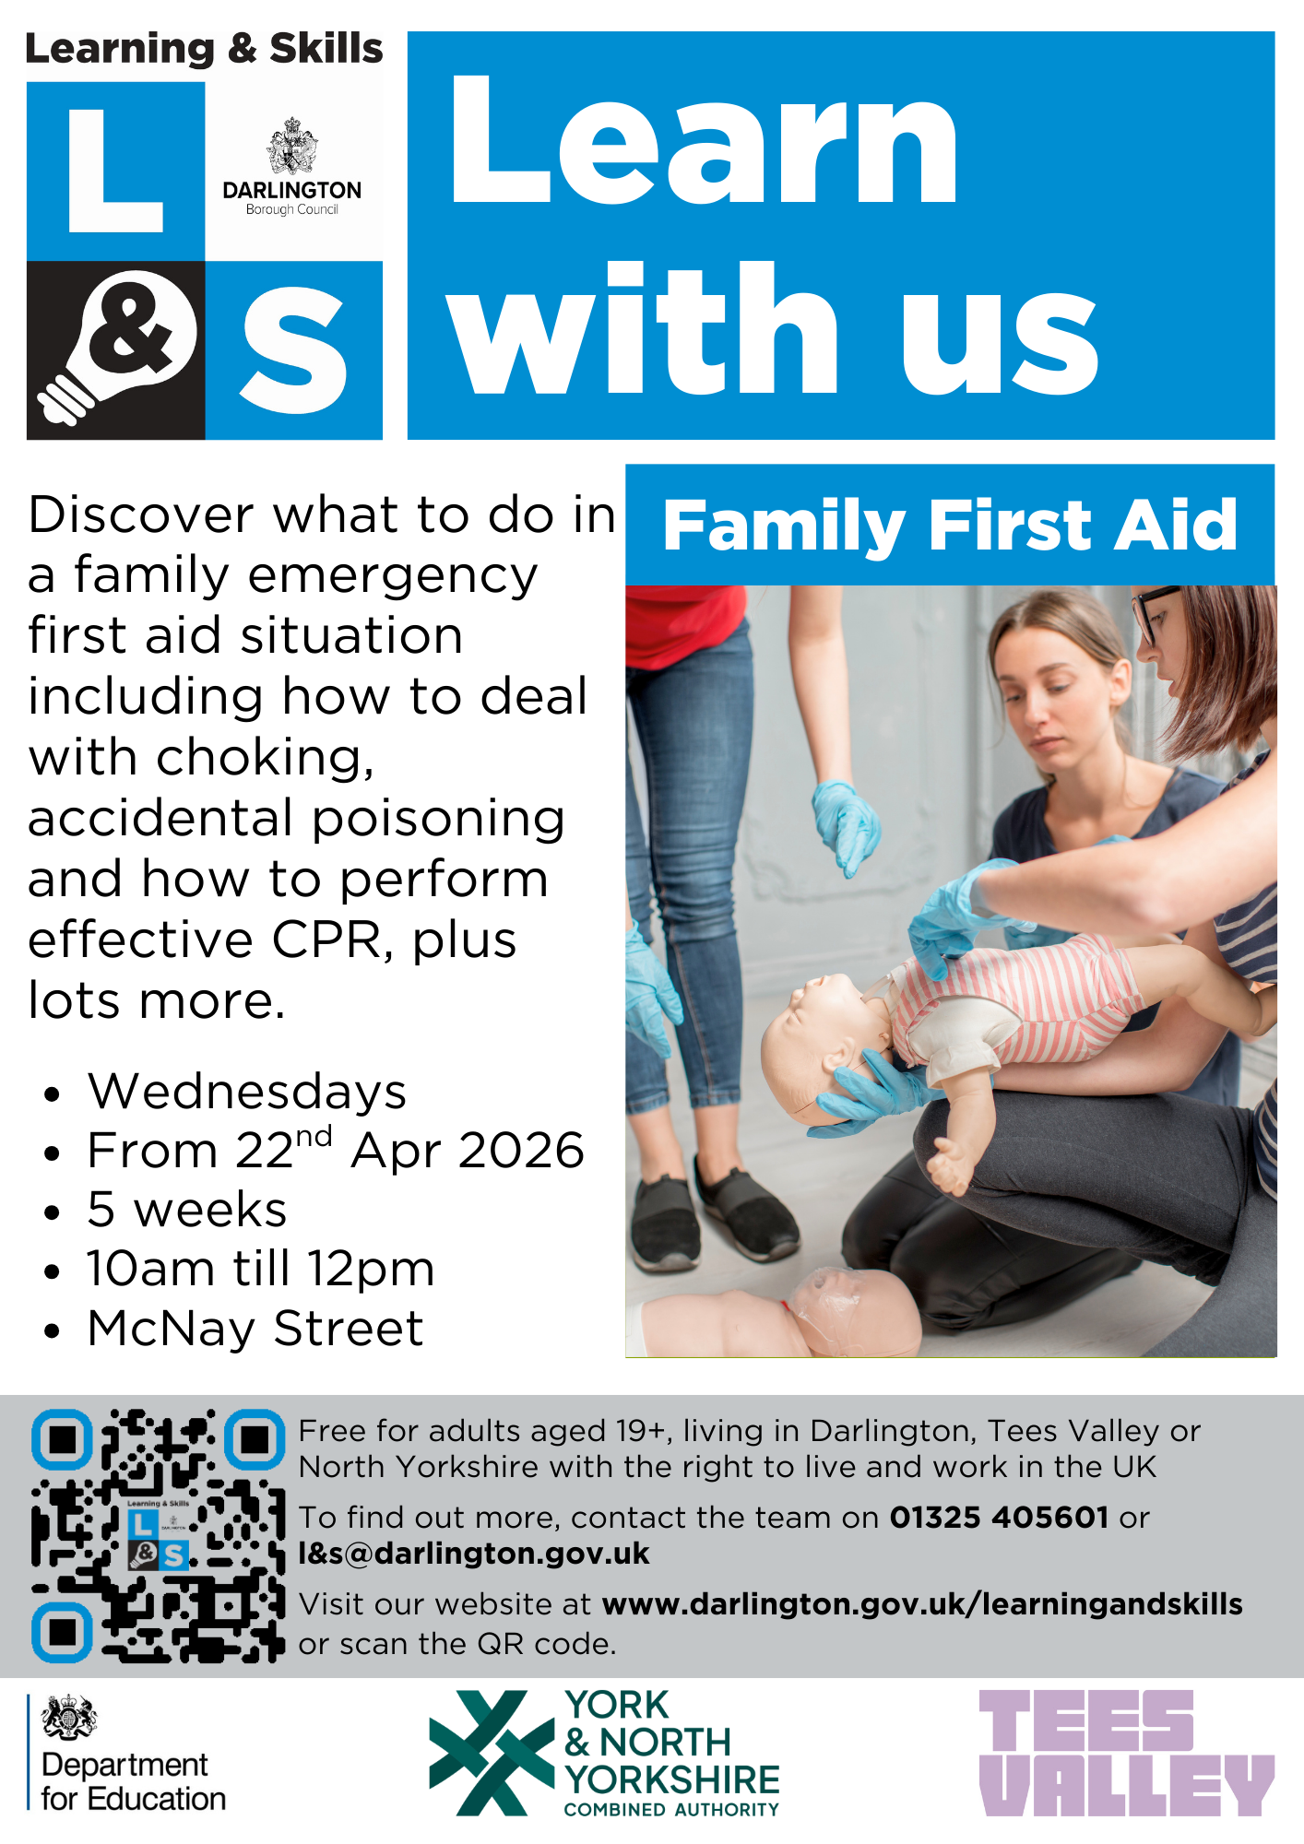
Notes:
The curriculum intent of Digital Skills/ICT is for learners to get to grips with a variety of ICT technology and learn how to effectively operate a computer/laptop, including safe internet searching, creating documents, adapt settings, using Microsoft Office and various other soft and hard ware, plus lots more. Computing Basics builds upon the skills learnt in Essential Computer Skills.
Must complete I/A

Slide 7
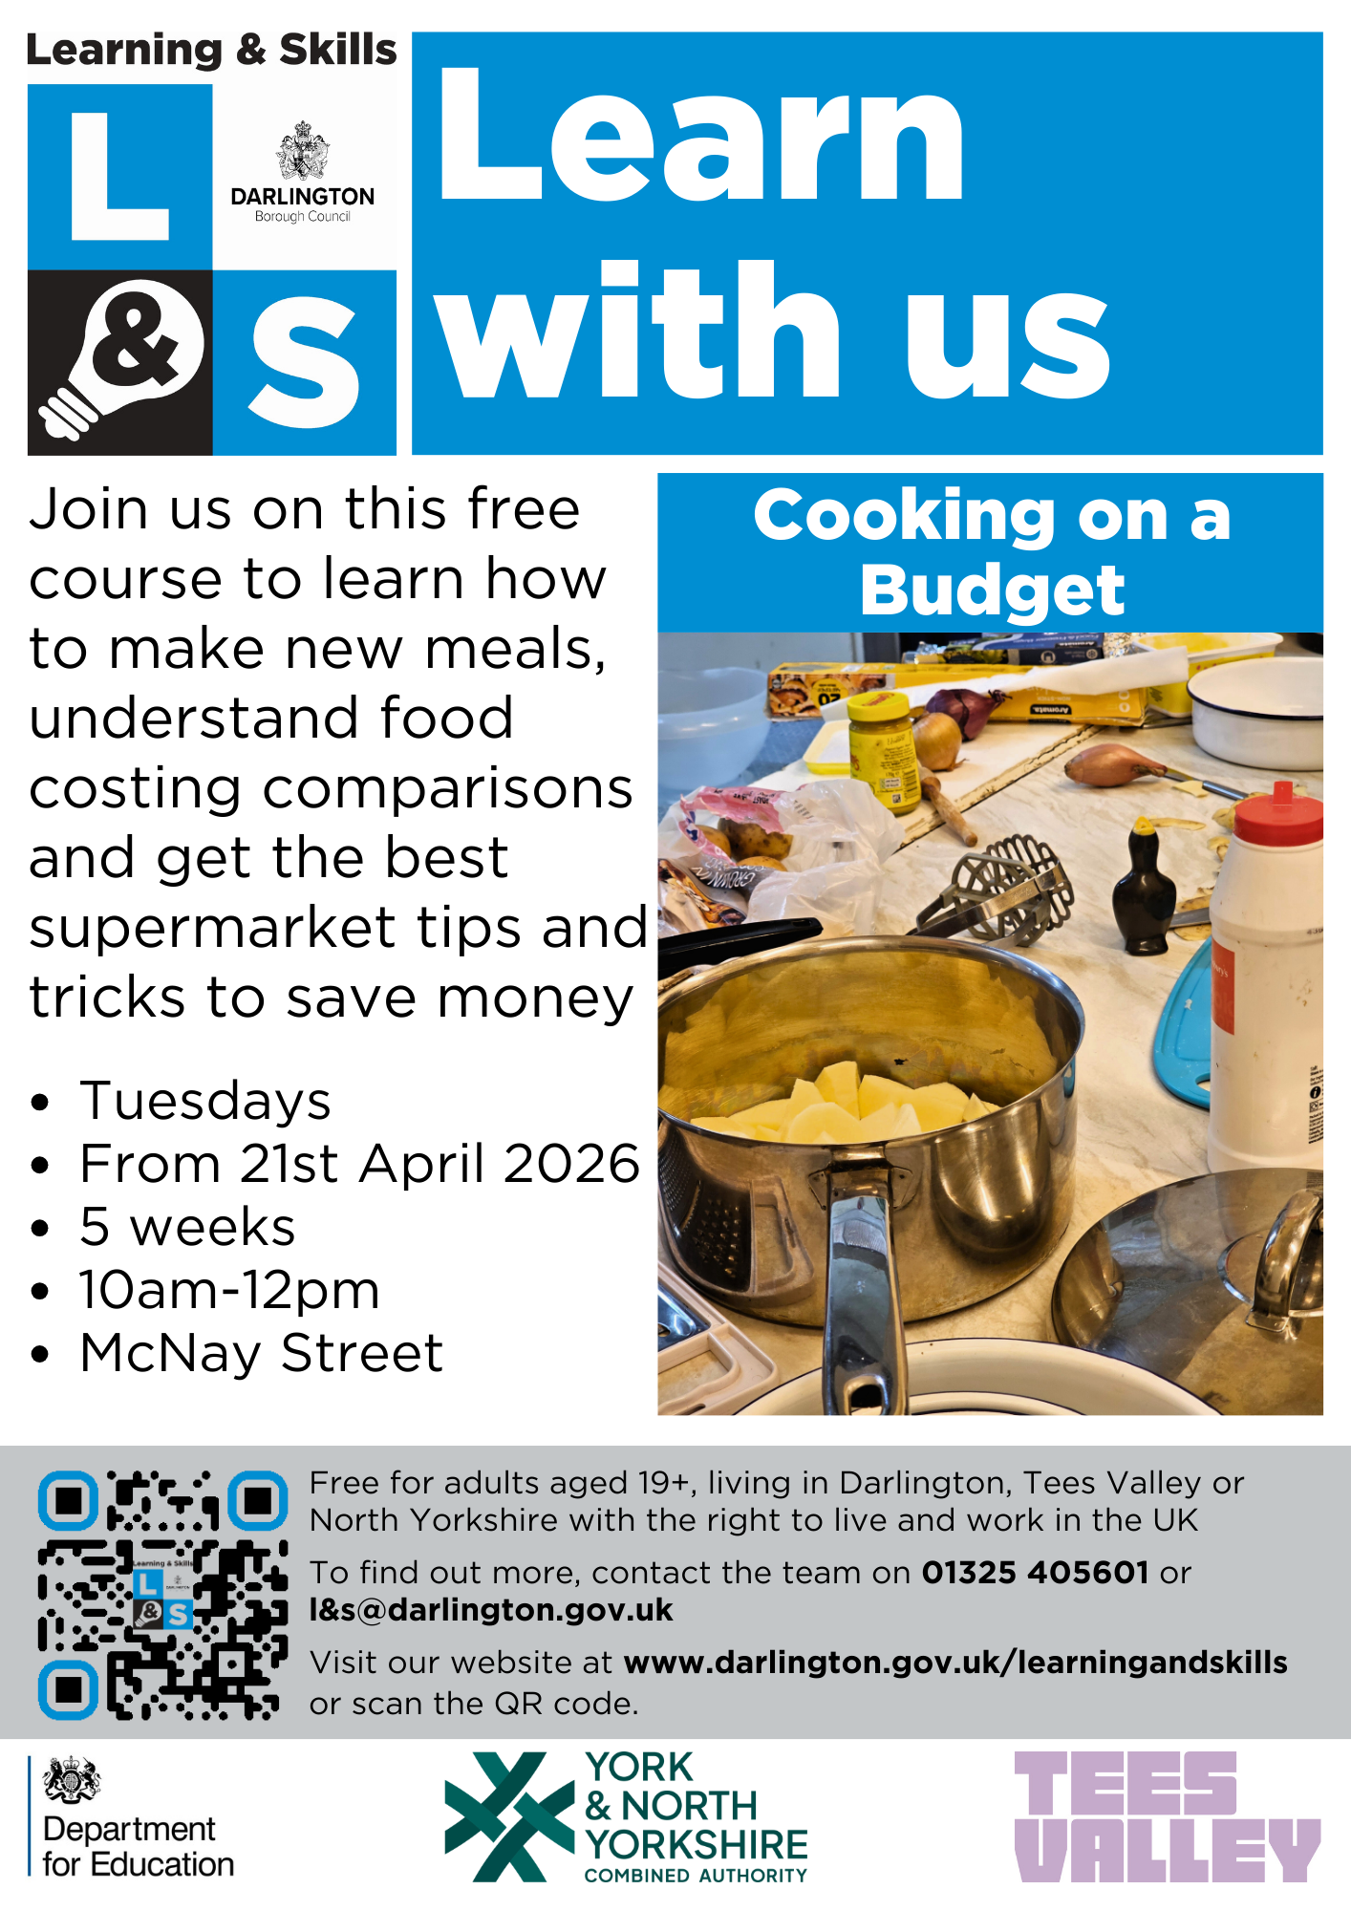
Notes:
This course is for anybody aged 19+ who wants to learn how to create simple and affordable meals. The course will cover food costing comparisons, supermarket tricks and plenty of recipes, like homemade pizzas, quiche and soup.

Slide 8

Notes:
This course is for anybody aged 19+ who wants to learn how to create simple and affordable meals. The course will cover food costing comparisons, supermarket tricks and plenty of recipes, like homemade pizzas, quiche and soup.

Slide 9
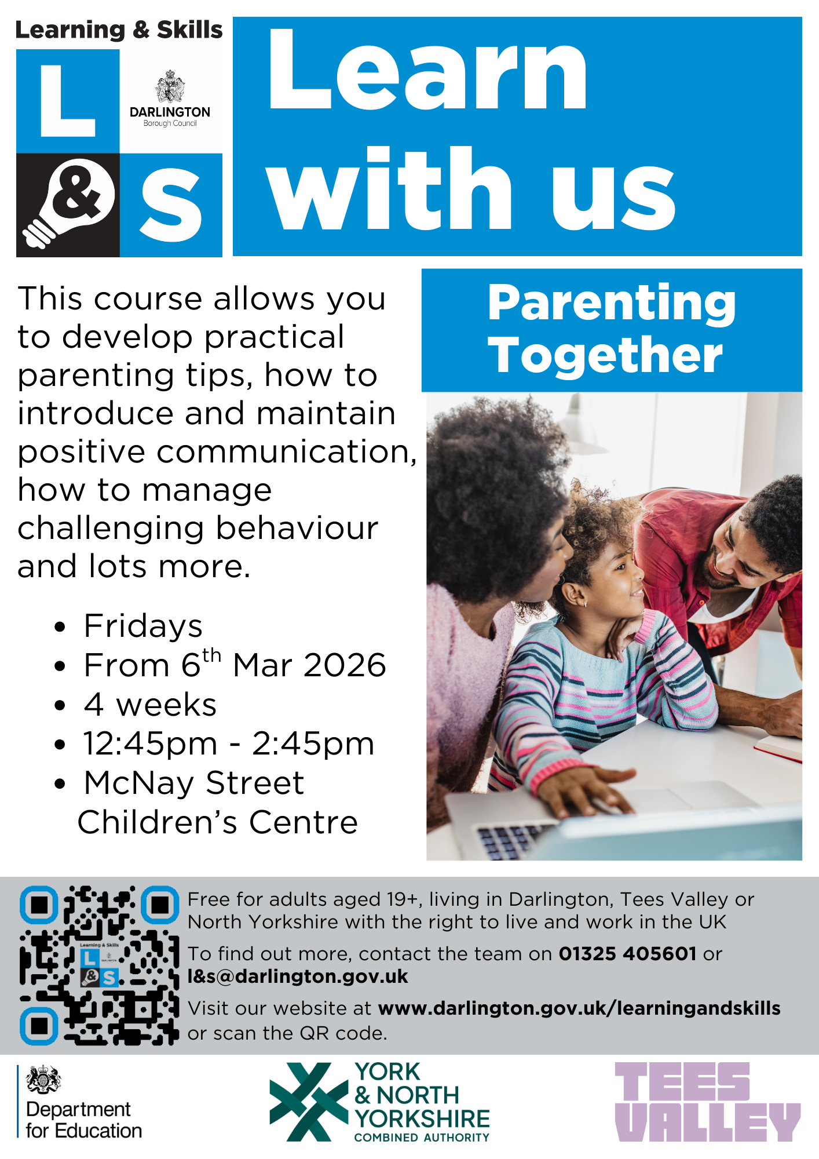
Notes:
This course is for adults with children up to the age of 11 years old or learners looking to boost their CV for a career in schools. You will learn how to identify effective parenting strategies, promote self-esteem, use positive communication skills and much more.

Slide 10

Notes:
We have the much awaited Level 1 Award in Preparing to Work in Schools starting on the 19th January for 12 weeks. This course is for people interested in volunteering or working in schools with the opportunity to develop their knowledge on the delivery of the national curriculum, understanding of the school structure, behaviour management

Slide 11

Notes:
We have the much awaited Level 1 Award in Preparing to Work in Schools starting on the 19th January for 12 weeks. This course is for people interested in volunteering or working in schools with the opportunity to develop their knowledge on the delivery of the national curriculum, understanding of the school structure, behaviour management

Slide 12


Slide 13
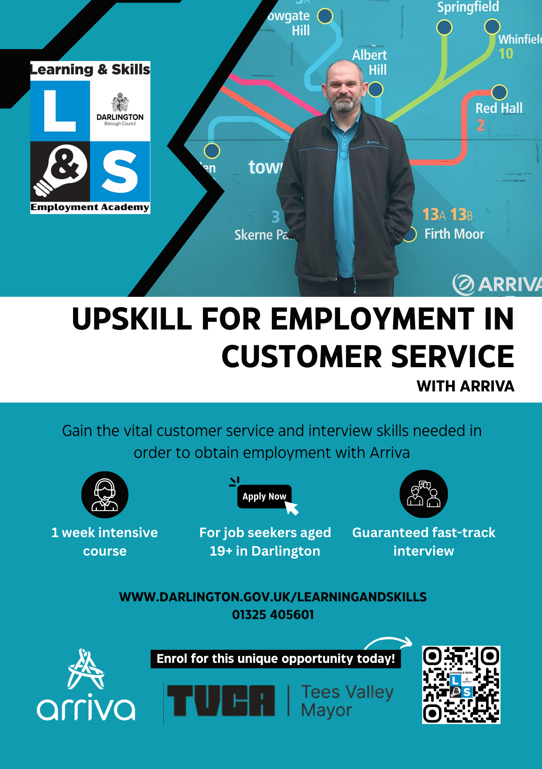

Slide 14


Slide 15
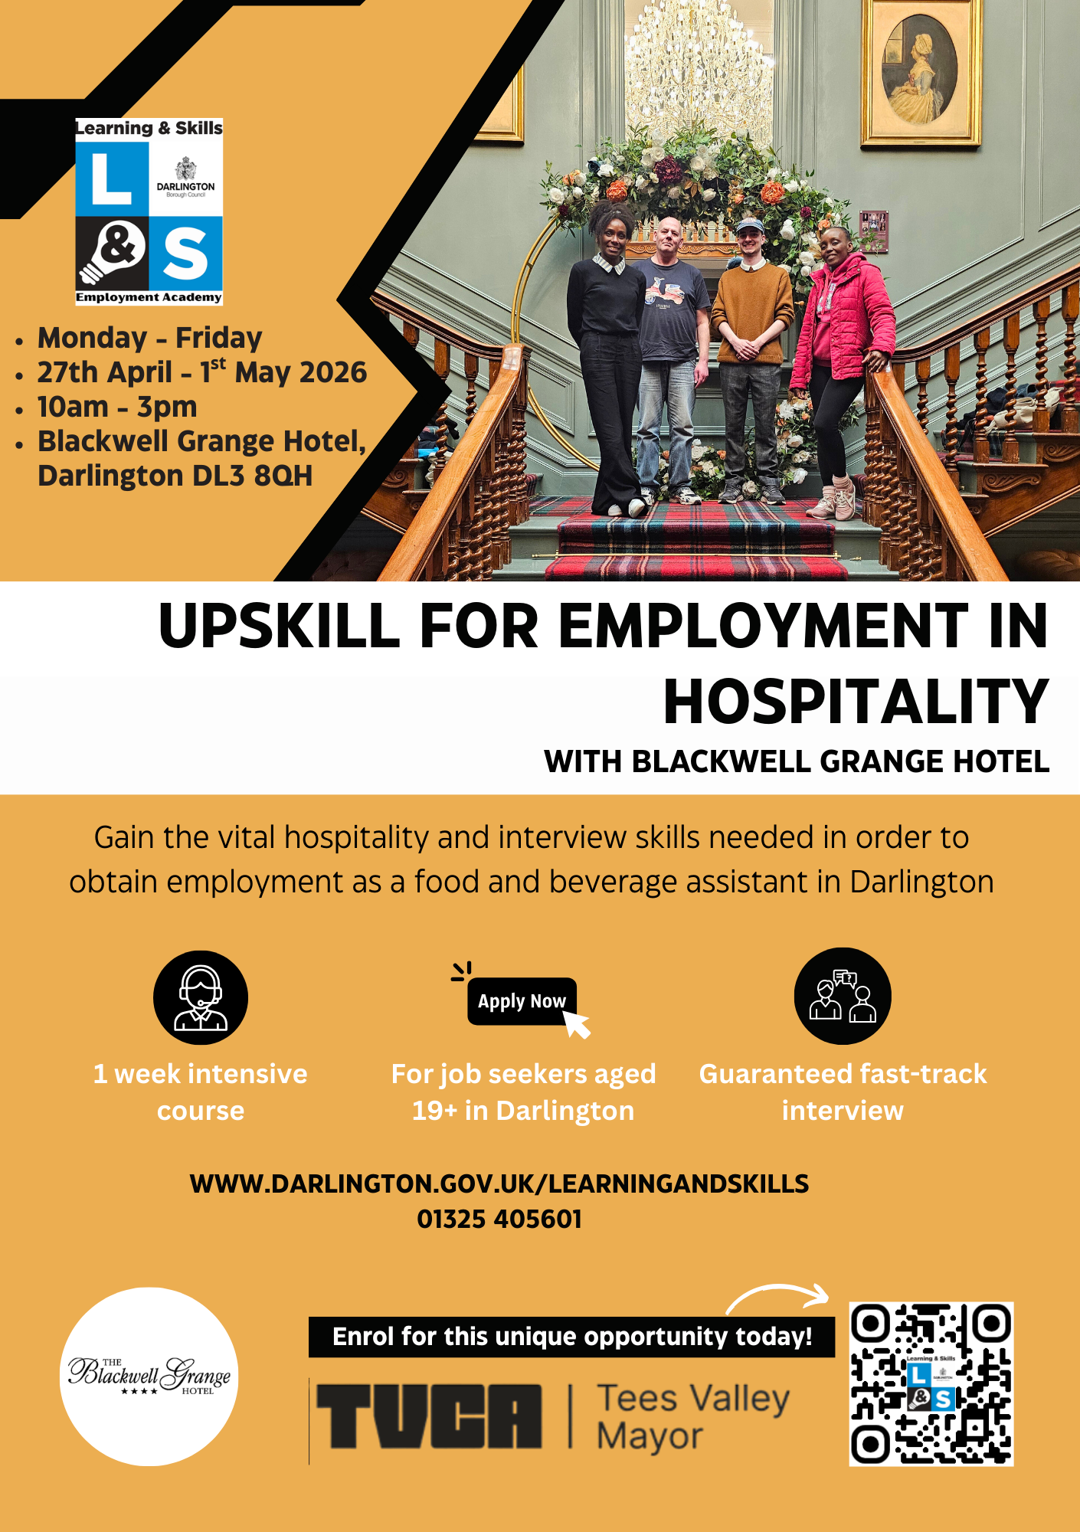

Slide 16
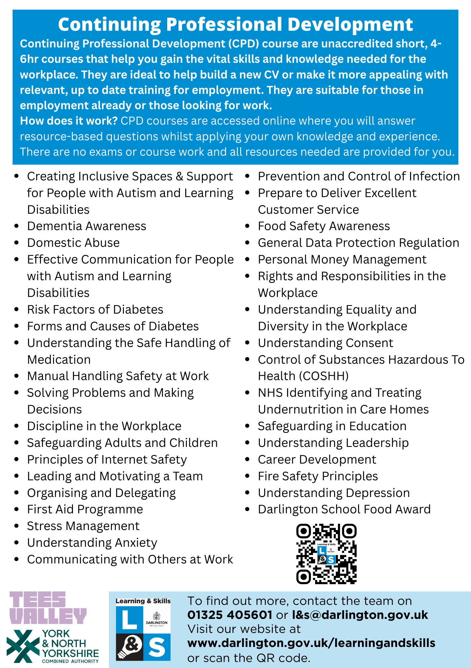
Free!!
Short online certified courses
Free!!

Slide 17
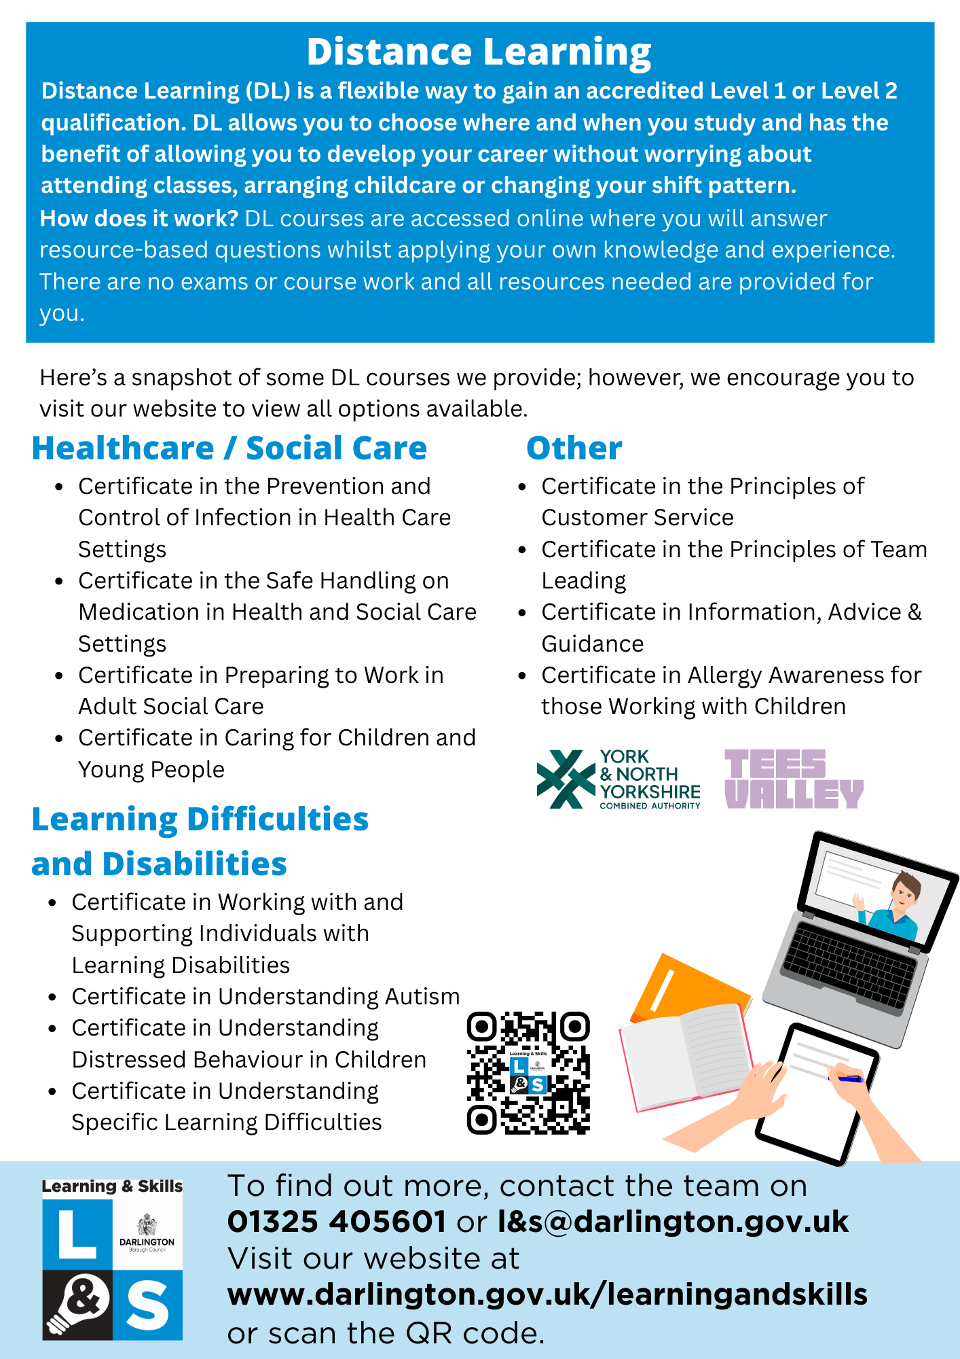
Free!!
12 Week accredited online courses.
Loads more on our website
Free!!

Slide 18
www.darlington.gov.uk/learningandskills

